Slide 1
Database Systems
COMP 3010E FALL 2025
Lecture 15 NoSQL Database

Slide 2
Agenda
RDBMS Limitations
NoSQL
    Common NoSQL storage models
    Related technologies in NoSQL

Slide 3
Relational Databases
  ACID (Atomicity, Consistency, Isolation and Durability)
  SQL
  MySQL, PostreSQL, Oracle
Dog:
id | name | mood | birth_date | color
12 | Stella | Happy | 2007-04-01 | NULL
13 | Wimma | Hungry | NULL | Black
9 | Ninjia | NULL | NULL | NULL

Slide 4
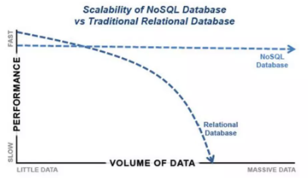
RDBMS Limitations
  Many issues while scaling up for massive datasets
  Not designed for distributed computing
  Expensive specialized hardware
  Multi-node databases considered as solutions - Known as 'scaling out' or 'horizontal scaling’
    Master-slave
    Sharding

Slide 5
NoSQL
  Not Only SQL: A general term for a class of distributed non-relational databases.
  A classification based on convention, or even a marketing slogan, rather than a strictly defined category.
  NoSQL can be subdivided into various data models, or can be a combination of multiple data models.
  NoSQL does not oppose the SQL language itself, but rather signifies its differences from Relational Database Management Systems (RDBMS).
  Most NoSQL technologies originated from internet companies and are better adapted to internet business needs.
  Most are open-source and free, but may lack comprehensive documentation and professional support services.

Slide 6
NoSQL Database Feature
  Large data volumes
  Scalable replication and distribution
    Potentially thousands of machines
    Potentially distributed around the world
  Queries require to return answers quickly
  CAP Theorem
  ACID transaction properties not needed
  Schema-Less Stores
  NoSQL cannot replace RDBMS

Slide 7
NoSQL
  Typical Application Scenarios of NoSQL
  Storage, retrieval, and querying of unstructured data
  Data caching and querying under high-throughput and low-latency requirements
  Log/data management and querying in IoT and monitoring systems
  Other industry applications

Slide 8
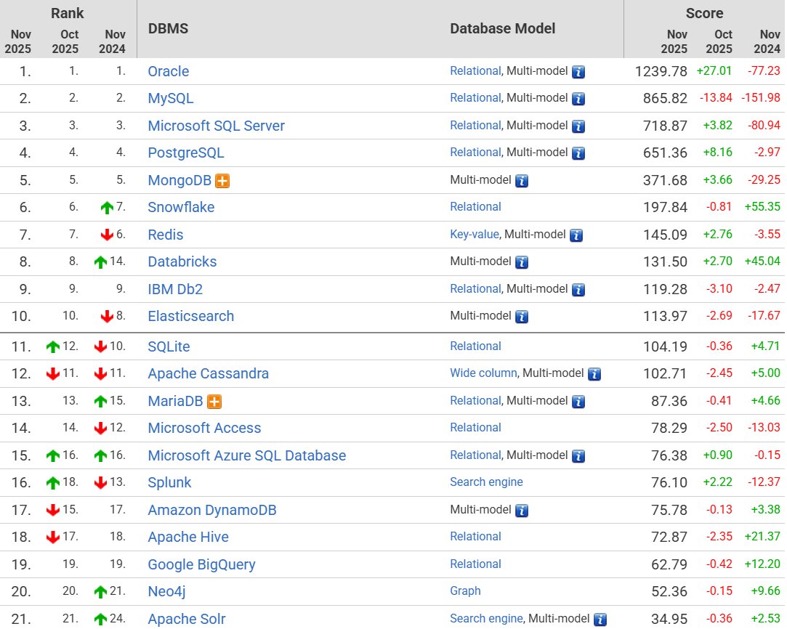
Reference for database popularity in November 2025

Slide 9
Common NoSQL Storage Models
  NoSQL lacks a unified storage model, with underlying engines varying significantly across implementations.
  Storage models commonly include Key-Value, Column-family, Document, and Graph.
  Many NoSQL systems combine multiple models, such as key-value and column-family storage.
  Most models (except graph storage) support distributed environments well, but typically only handle simple queries, with limited support for joins and complex queries.
  Indexing support, including secondary indexes, is generally weak.

Slide 10
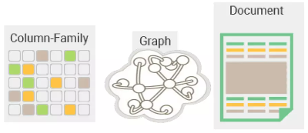
Common NoSQL Storage Models
  Key-Value Store – Big Hash Table of keys & values
  Document-based Store - Stores documents made up of tagged elements (CouchDB, MongoDB)
  Column-based Store - Each storage block contains data from only one column
    Google BigTable
    Cassandra
    Hbase
  Graph-based
    A network database that uses edges and nodes to
    represent and store data (Neo4J)
Schema-less - column-based, document-based, graph-based

Slide 11
Key-value Stores
  “One key, one value, no duplicates, and crazy fast.”
  A simple Hash table!
  The Key-Value pair, in its physical structure, is formatted as: <key, value>, or in variants such as <key, value, timestamp>.
  In practical systems, data is often sorted locally within shards based on the key to improve retrieval efficiency.
  Databases such as Redis, HBase, and Cassandra​ utilize this storage model.

Slide 12
Key-value Stores
  “One key, one value, no duplicates, and crazy fast.”
  A simple Hash table!
  Read and write values using a key
    Get(key), returns the value associated with the provided key
  Put(key, value), associates the value with the key
“value”
“key”
…
name_$#_Stella^^^
mood_$#_Happy^^^
birthdate%///
135465645)
…
id | name | mood | birth_date | color
12 | Stella | Happy | 2007-04-01 | NULL
13 | Wimma | Hungry | NULL | Black
9 | Ninjia | NULL | NULL | NULL
dog_12

Slide 13
Document Stores
  The data is a collection of key value pairs, is compressed as a document store similar to a key-value store
  Difference is that the values stored (documents) provide some structure and encoding of the managed data
  XML, JSON (Java Script Object Notation), BSON (binary JSON objects) are some common standard encodings
  Amazon SimpleDB, CouchDB, MongoDB…

Slide 14
Example (Document Stores)
“document”
“key”
{
type: “Dog”,
name: “Stella”,
mood: “Happy”,
birthdate: 2007-04-01
}
dog_12
vs.
id | name | mood | birth_date | color
12 | Stella | Happy | 2007-04-01 | NULL
13 | Wimma | Hungry | NULL | Black
9 | Ninjia | NULL | NULL | NULL

Slide 15
Column Stores
  Data stored in cells grouped in columns of data rather than rows
  Columns logically grouped into column families
  Families can contain a virtually unlimited number of columns that can be created at runtime or the definition of the schema
  Read and write is done using columns rather than rows
  Pros: fast search/ access and data aggregation
  Store all the cells corresponding to a column as a continuous disk entry thus makes the search/access faster

Slide 16
Column Stores – Data Model
  ColumnFamily - A single structure that can group Columns and SuperColumns
  Key - permanent name of the record. Keys have different numbers of columns, so the database can scale in an irregular way
  Key-space - Defines the outermost level of an organization, typically the name of the application
  Column - Ordered list of elements -Tuple with a name and a value defined

Slide 17
Example (Column Stores)
“column”
“row-id”
“column family”
“title”
“time”
“value”
dog | birthdate | 15
dog | mood | 11
dog | mood | 45
dog | name | 25
dog | color | 34
2007-04-01
Angry
dog_12
Happy
Stella
Black
vs.
id | name | mood | birth_date | color
12 | Stella | Happy | 2007-04-01 | NULL
13 | Wimma | Hungry | NULL | Black
9 | Ninjia | NULL | NULL | NULL

Slide 18
Graph Databases
  Relational database is a collection loosely connected tables
  Graph database is a multi-relational graph
  Stores data as relationships between vertices (or nodes) and edges.
    A vertex, connected by edges, contains associated information such as a name, type, properties, and its connected edges.
    An edge​ is typically directed​ (unidirectional) and contains information such as a name, type, start and end vertices, and properties.
    Neo4j, InfoGrid, …

Slide 19
Example (Graph Stores)
Dog
Stella
name
type
Happy
mood
dog_12
barks
bark_59
I had to wear stupid…
birth_date
comment_to
2007-04-01
comment_83
You look so Cute
comments
dog_4

Slide 20
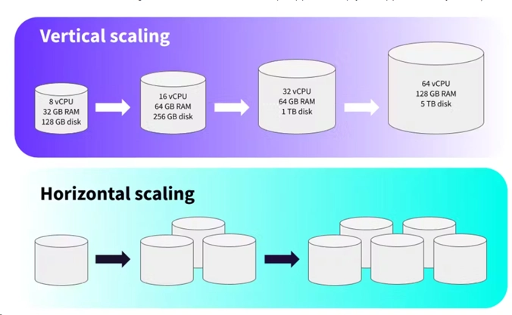
NoSQL DB Scaling up

Slide 21
Consistency Issues
  Objectives
    The consistency problem arising from data replication in distributed systems, particularly in NoSQL databases.
    A further goal: Achieving consensus among various nodes on a specific topic (e.g., configuration information updates).
  Conceptual Differences
    Consistency in ACID: Emphasizes that the state of the data (constraints, integrity, etc.) remains valid both before and after (one or multiple) transactions.
    Consistency in CAP: Emphasizes that multiple replicas are state-consistent and synchronously updated.

Slide 22
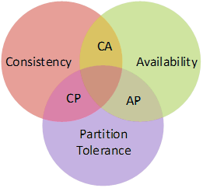
The CAP Theorem
  CAP​ refers to the three properties in a distributed system: Consistency, Availability, and Partition Tolerance.
  Consistency: All nodes in a distributed system must reach consensus on a given data item.
  Availability: Refers to the system's responsiveness or speed in handling requests.
  Partition Tolerance: The system remains operational and can service data requests despite node failures or network message loss, typically through data replication.
  Can only achieve two out of the three at any given time.

Slide 23
Other Related Technologies in NoSQL
  Distributed Big Data Processing
  NoSQL systems generally do not provide complex data processing capabilities.
  Big data processing is often distributed, multi-stage, and time-consuming, requiring solutions to a series of challenges:
    Resource Allocation in Clusters:​ Allocating appropriate resources across nodes, such as memory size and CPU capacity.
    Task Scheduling: Managing multiple task queues.
    Multi-stage Processing:​ Handling intermediate data distribution and aggregation across processing stages.
    Monitoring and Fault Tolerance:​ Monitoring task progress, detecting failures in sub-tasks, and providing resilience.
    Usability:​ Ensuring ease of use for the entire system.
  Common big data processing frameworks include Hadoop​ and Spark.

Slide 24
Other Related Technologies in NoSQL
  Time Synchronization Service
  In distributed applications, it is often necessary to ensure that the time is consistent across all nodes.
    Otherwise, nodes may fail to perform notifications, synchronization, or consistency checks based on mechanisms like timestamps. In practice, if the time difference between nodes is too large, the cluster may fail to start.
    In NoSQL and big data applications within a Local Area Network (LAN), real-world time synchronization may not be required, but time consistency across all nodes is essential.
  NTP (Network Time Protocol)​ is a common mechanism for distributed time synchronization.
    The NTP protocol has been developed to version 4, achieving millisecond-level accuracy, and has become an international standard (IETF RFC 5905).

Slide 25
Other Related Technologies in NoSQL
  Bloom Filter
  The Bloom filter has a long history and was not specifically designed for distributed applications.
  Its purpose is to check whether an element exists within a set (e.g., a data block).
  Its advantages are low space overhead and fast query speed. The main drawback is a false positive rate: the Bloom filter may falsely indicate an element is in the set, but if it shows the element is absent, it is definitely not present.
  Scenario: A node containing multiple data files may need to scan all files sequentially during data retrieval, which can be slow due to hardware limitations. Despite the false positive rate, the Bloom filter can quickly eliminate irrelevant files, significantly speeding up the scan.

Slide 26
RDBMS vs NoSQL
  Features and functionalities in RDBMS may be abandoned or weakened in NoSQL
RDBMS | NoSQL Database
Relations, (Row-Oriented) Two-Dimensional Table Structures | Adopts alternative structures such as Key-Value Pairs, Columnar Storage, Document Storage, etc.
Integrity Constraints, Design Paradigms (Normal Forms) | NoSQL may not require column atomicity, does not support referential integrity, and does not adhere to design paradigms like 1NF, 2NF, etc.
Transaction Mechanisms, Strong Consistency, ACID​ Properties | Focus on CAP Theorem​ and BASE​ principles (Basically Available, Soft state, Eventual consistency)
SQL​ (and the powerful querying and manipulation capabilities it represents) | May provide query languages similar to SQL, but generally do not support complex operations like cross-table joins.

